Slide 1
CELESTIAL-GANS
How AI sees the universe

Slide 2
Project Details
36
P1
Dr. P.S. Banerjee
Project No.
26th Sept, 2022
Guide

Slide 3
Table of contents
01
Description
02
TechStack
03
System Arch
04
Conclusions

Slide 4
01
Description
Selection of Project Idea and Project Structure

Slide 5
Motivation for Project Idea
First of all, we love astronomy.
Beauty of Universe is what inspires and fascinates us.
Creating new images of celestial objects
Ever wondered how AI sees our universe. Let’s Find.
Explore more about the applications of GANs

Slide 6
About the project
Today's AI is capable of creating new images by studying a database of existing ones to understand how to create new ones.
Project Structure:
Dataset Building by using scraped images
GANs Research and Model training
Generation of new Images

Slide 7
02
TechStack
Tools and Technologies Used

Slide 8
Tools and Technologies
Deep Learning
Artificial Intelligence
Generative Adversarial Networks (GANs)
Convolutional Neural Networks (CNN)
Python
Pytorch
StyleGAN2
Lightweight GAN
SrGAN
Flickr Scraper
Jupyter Notebook

Slide 9
GANs and Introduction
GANs were first introduced in 2014 by Ian Goodfellow
Generative Models had started showing promising results in generating realistic images.
GANs are interesting as they can learn to approximate data distribution (aka mimic real data)
They’re powerful as now it can generate images, audios clips, videos which do not exists in reality.

Slide 10
GANs _{( Utility)}
GANs are usually trained in a self-supervised fashion, i.e. they use the unlabelled data as the supervisory signal.
If Gan’s becomes better at creating data then it will also be able to understand the data which is present in the world much better than any other algorithms.
They’re powerful as it can generate images, audios clips, videos which do not exists in reality.

Slide 11
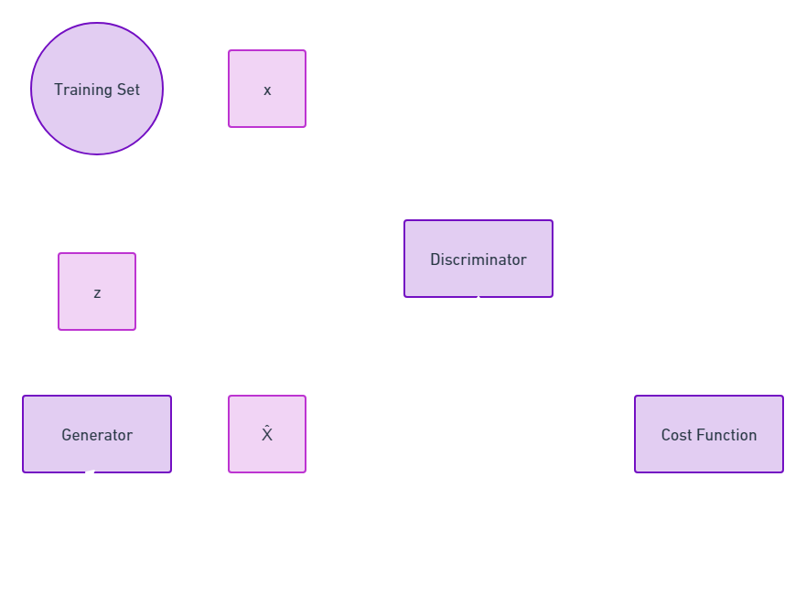
GAN Architecture
Real Sample
Noise
Real or Fake
Fake Sample
Backpropagation

Slide 12
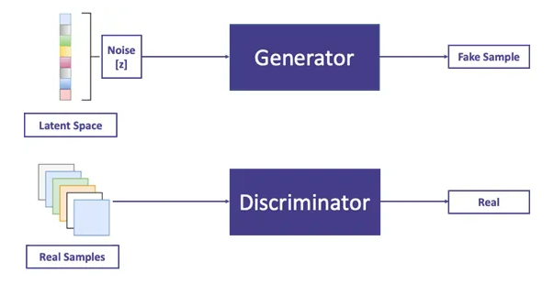
Generator
Generates Synthetic samples with some Noise.
Samples termed as Fake Sample
Sampled from Latent Space
Generator Tries to fool Discriminator into classifying Fake sample as real sample

Slide 13
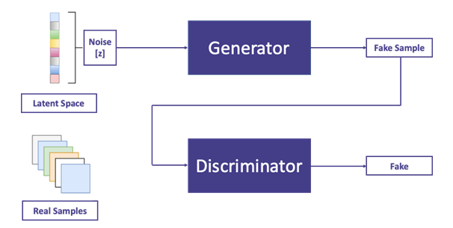
Discriminator
Binary Classifier (0,1)
Discriminates between Real and Fake Sample
Discriminator tries not to get fooled by Generator
Generator wants to generate samples in a way so that the Discriminator makes a mistake in calling it out as a real one.

Slide 14
What I cannot create,
I do not understand
One of the famous quotes which
explains the intuition behind Gan’s.
~ Richard Feynman
(Theoretical Physicist)

Slide 15
03
System Arch
Design and Build of Project Structure

Slide 16
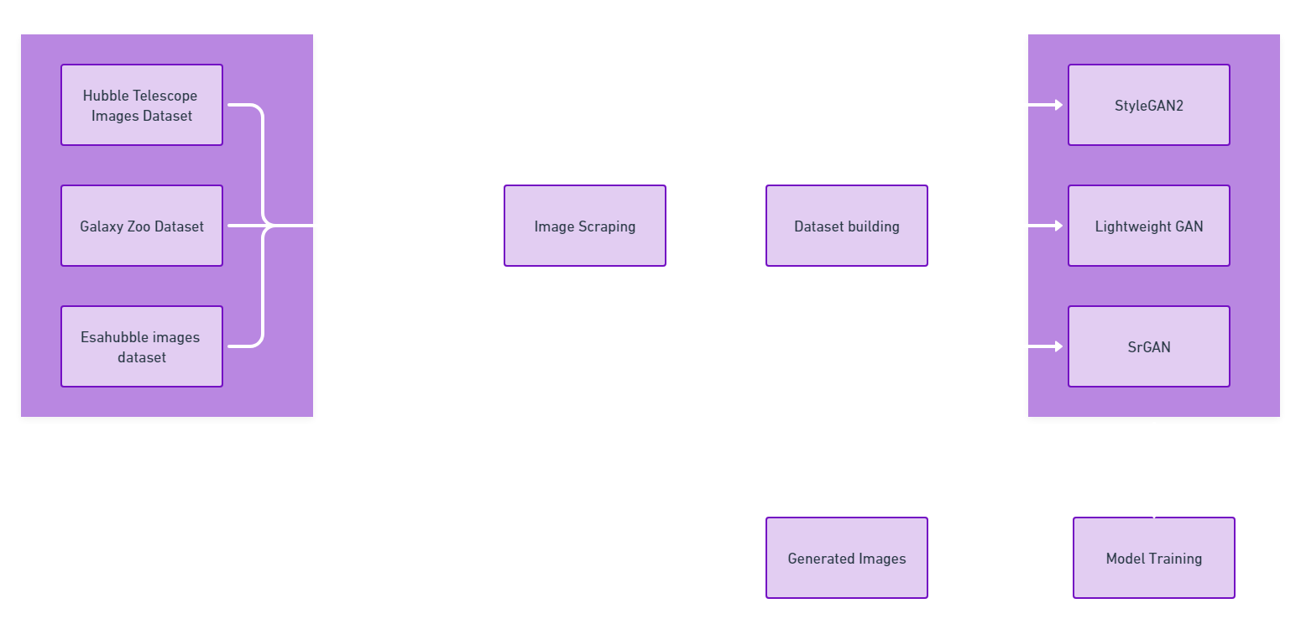
Image Sources
Various GANs Used

Slide 17
04
Conclusion
Summarized expected results and Outcomes

Slide 18
Generative Adversarial Networks is the most interesting idea in machine learning in last ten years.
~ Yann Yecun
(Facebook AI Director)

Slide 19
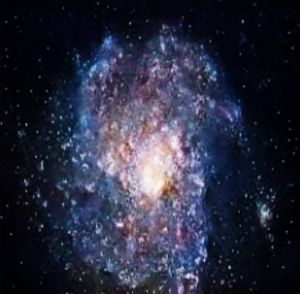
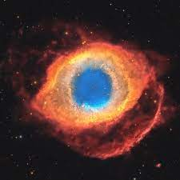
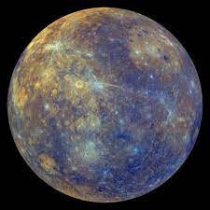
Results
Celestial Bodies generated by using GANs
Galaxy
Nebulae
Planet

Slide 20
References
https://neptune.ai/blog/6-gan-architectures
https://blog.paperspace.com/complete-guide-to-gans/
https://machinelearningmastery.com/introduction-to-style-generative-adversarial-network-stylegan/
https://developers.google.com/machine-learning/gan/gan_structure

Slide 21
Timeline
Building and Training Model
Research
Dataset Creation
P1
P2
P2
P2
P3
P3
Scraping Images
GANs Application
Outcomes

Slide 22

Our Team
Garima Shukla
201B109
Vani Seth
201B299
Tanish Khandelwal
201B283

Slide 23
THANK YOU

